Slide 1
Neutron Dosimetry/ Spectrometry for the Purpose of Calibration in Vietnam
Le Ngoc Thiem Email: Thiem.LNT@gmail.com
Institute for Nuclear Science and Technology
179 Hoang Quoc Viet, Cau Giay, Hanoi, Vietnam

Slide 2
CONTENTS
Introduction to INST (Vinatom)
Materials investigated at INST
Establishment of Neutron Calibration Fields at INST (Vietnam)
Summary

Slide 3
Introduction to INST (Vinatom)
Ministry of Science and Technology (MOST)
VINATOM (Technical Supporting Organization)
VARANS (Authority body)
INST (Hanoi)
OTHERS (Dalat, HCM, Hanoi, Danang)
Domestic Calibrations of Ionizing radiation measuring devices including neutron meters
Available Calibration Fields:
Gamma
X-ray
Neutron
Neutron Calibration Fields have been established since 2015
²⁵²Cf
²⁴¹Am-Be
Moderated ²⁴¹Am-Be

Slide 4
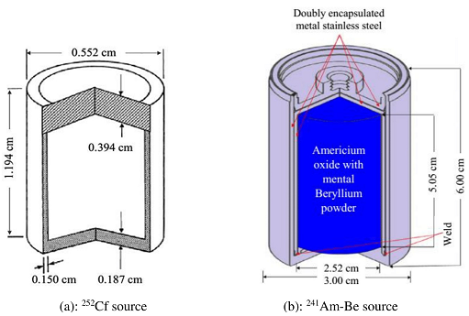
Materials investigated at INST (related to neutron dosimetry)

Slide 5
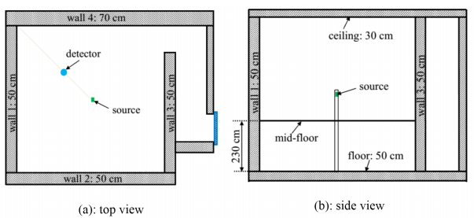
1. Neutron source and calibration room

Slide 6
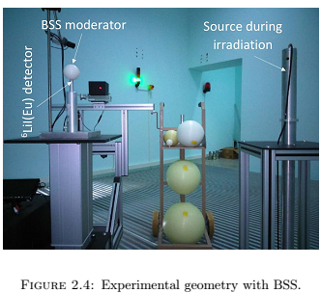
Photo of neutron calibration room

Slide 7
2. Bonner Sphere Spectrometer (BSS)

Slide 8
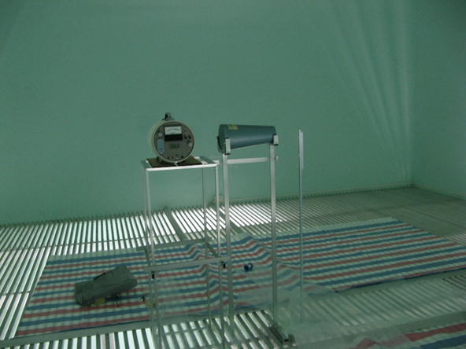
3. ISO standards: ISO 8529, ISO 12789

Slide 9
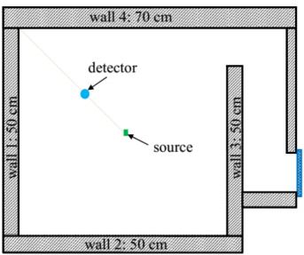
4. MCNP SIMULATION

Slide 10
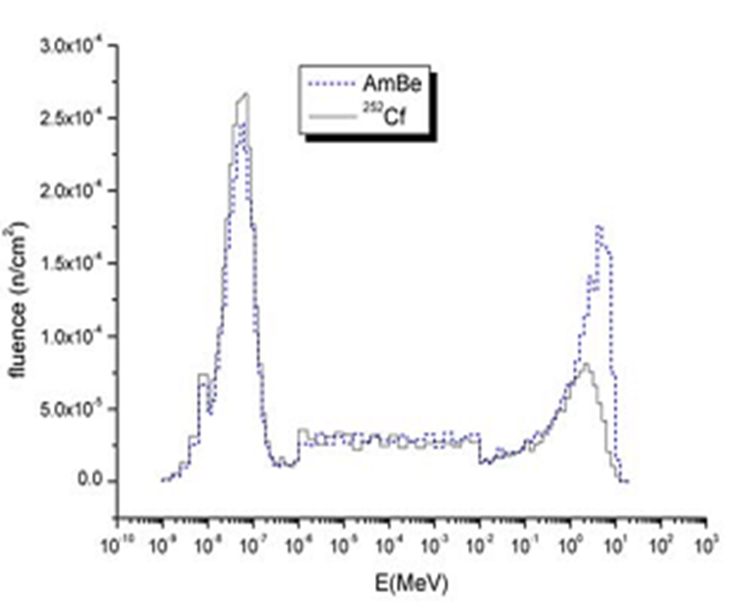
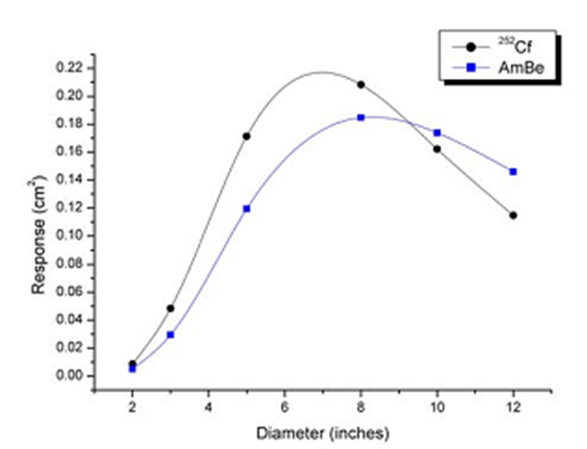
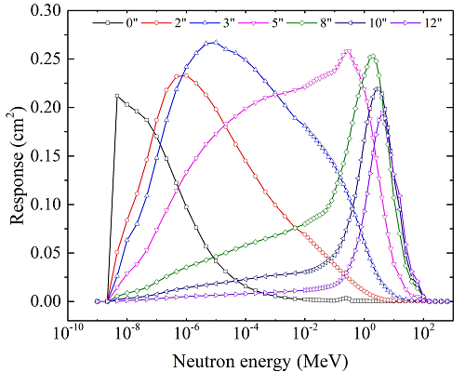
5. Unfolding codes: MAXED, GRAVEL, FRUIT, MSITER, etc
Readings from the different BSS spheres (i=1-6)
Spectrum (Initial guess needed)
Solution Spectrum, Φ
Response Functions of BSS spheres – IAEA Pub./Sim.
+

Slide 11
Neutron Calibration Fields Established at INST (VN)
+ 01 Low Neutron Strength Calibration Field of a Bare ²⁵²Cf Source
+ 01 Medium Neutron Strength Calibration Field of a Bare ²⁴¹Am-Be Source
+ 05 Moderated Neutron Calibration Fields of ²⁴¹Am-Be Source

Slide 12
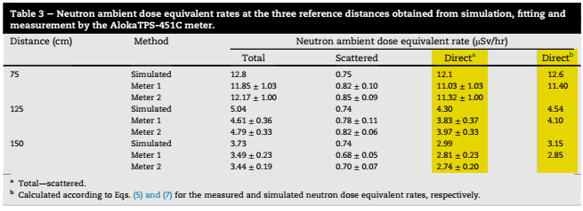
1. Neutron Calibration Field of ²⁵²Cf Source

Slide 13
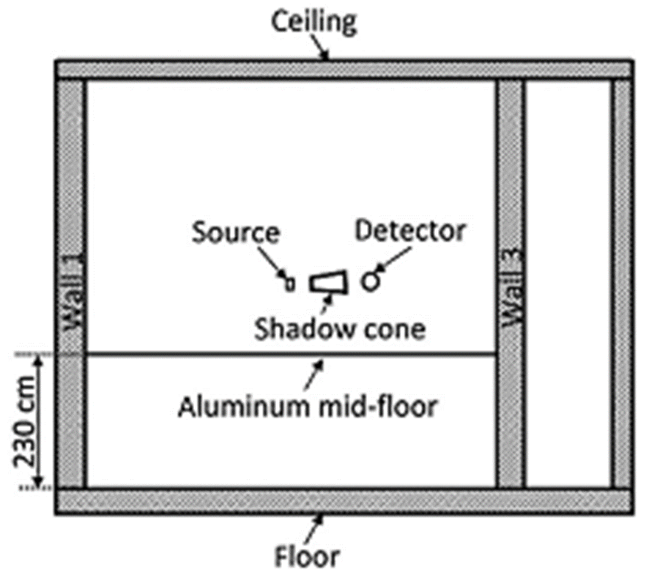
a. Neutron Spectra
(Distribution of neutron fluence rate as a function of neutron energy)

Slide 14
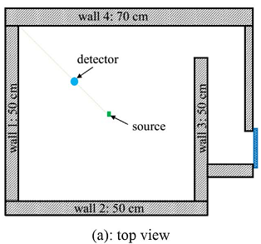
b. Spacial distribution of neutron fluence rate
Y
X

Slide 15
c. Shielding efficiency of the Shadow Cone

Slide 16
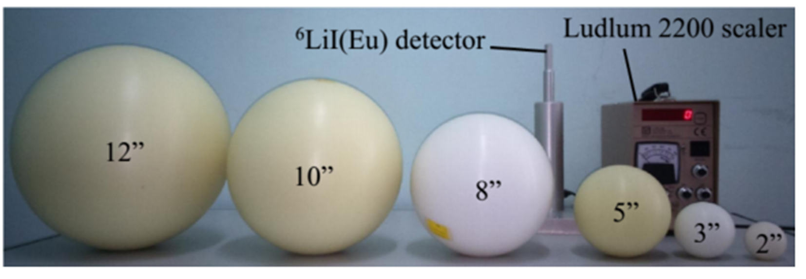
2. Neutron Calibration Field of ²⁴¹Am-Be Source

Slide 17
Experimental Flow Chart
4
Direct-nSpec
5’
Dir-nDE
Direct
Count Rate
5
unfolding
ISO
BSS Total Count Rate
3
ISO 8529
1
Resp. Function
Guess Spec
Fitting
Scatterred-nSpec
6’
Scattered
Count Rate
6
Total-Direct
=
Total-nSpec
unfolding
2
2’
Tot-nDE
ICRP74

Slide 18
Calculation of n-H*(10) from n-Spec
1
1’
Tot-nDE
2
2’
Dir-nDE
3
Tot-nDE – Dir-nDE = Sct-nDE
4
FF-nDE

Slide 19
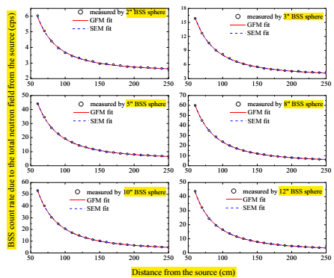
Fitting Reliability
Total count rate
Fitting
(DiR, SCT) Count rate
seperation
unfolding
Diff. Component
Count rate

Slide 20
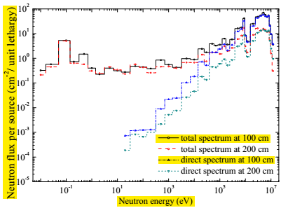
N-Spectra
N-Dose Equivalent)
Next-slide

Slide 21
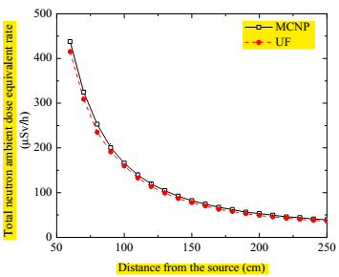
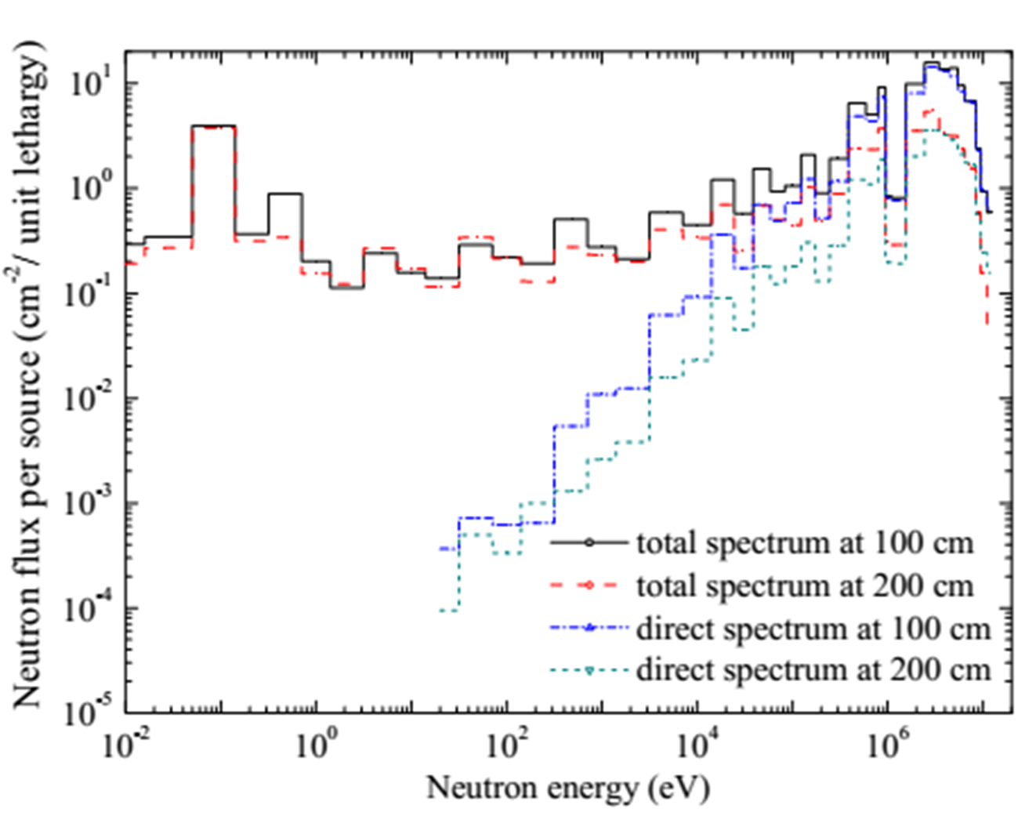
Total N-Dose Equivalent Rates

Slide 22
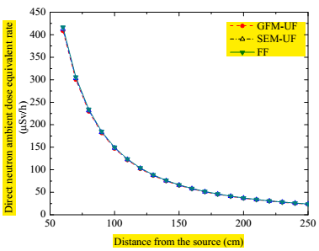
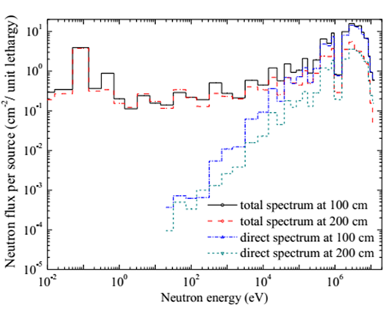
DIRECT N-Dose Equivalent Rates

Slide 23
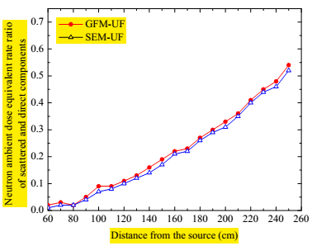

Slide 24
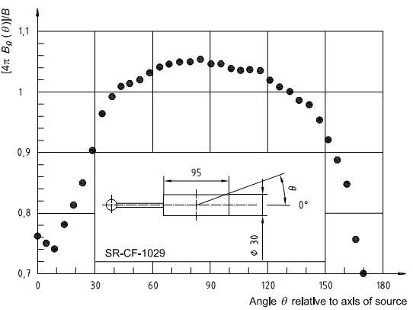
Neutron source anisotropy correction factor - F₁(θ)
1.030
60

Slide 25
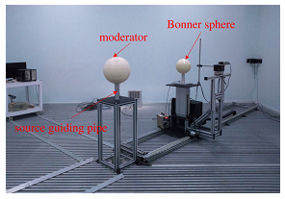
3. Simulated Workplace Neutron Calibration Field of ²⁴¹Am-Be Source

Slide 26
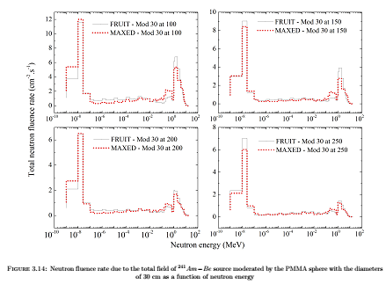
Neutron Spectra

Slide 27
n-H*(10) vs Distance from the source

Slide 28
Total n-Fluence Rate vs Distance

Slide 29
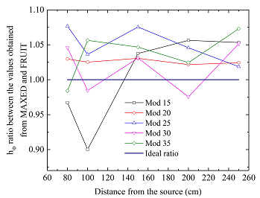
Φ to H*(10) conversion factor, h_{Φ}(10)

Slide 30
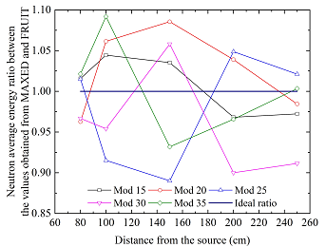
E_{tb-DE} vs Distance

Slide 31
Summary
07 neutron calibration fields have been established at INST
Neutron spectrum at the point of interest has been determined
Neutron dose equivalent rate at the point of interest has been investigated
Conventional true values of the interested quantities have been calculated
Calibrations of Neutron measuring devices are ready at INST

Slide 32
References
Thiem Ngoc Le et al.; Characterization of a neutron calibration field with ²⁴¹Am−Be source using Bonner sphere spectrometers; Applied Radiation and Isotopes; Vol. 133, 2018, pp. 68–74.
Thiem Ngoc Le et al.; Neutron calibration field of a bare ²⁵²Cf source in Vietnam; Nuclear Engineering and Technology; Vol. 49(1),2017, pp. 277–284.
Thiem Ngoc Le et al.; Neutron calibration field at Institute for Nuclear Science and Technology; Nuclear Science and Technology; Vol. 6(4), 2016; pp. 1–7.

Slide 33
Thank you for your attention

