Slide 1
The 3rd National Nuclear Regulatory Conference in Viet Nam Cooperating with EC to enhance capability of nuclear regulatory body of Viet Nam Jorge TIRIRA - ASN Ha Long city, 25 July 2018
These projects are funded by the European Union

Slide 2
Outline
The instrument for nuclear safety cooperation
Synthesis of INSC Projects for Viet Nam
Synthesis of the activities carried out
Conclusions

Slide 3
The instrument for Nuclear Safety cooperation
INSC

Slide 4
Instrument for Nuclear Safety Cooperation
Due to global challenges and the need for the EU to take action in this field, the EU supports the promotion of a high level of nuclear safety, radiation protection, and the application of efficient and effective safeguards of nuclear material in third countries.
The geographical scope of the Instrument for Nuclear Safety Cooperation (INSC) extends to all third countries, but priority is given to accession and neighbouring countries.

Slide 5
Instrument for Nuclear Safety Cooperation
Among the objectives:
The promotion of an effective nuclear safety culture and implementation of the highest nuclear safety and radiation protection standards, and continuous improvement of nuclear safety
Responsible and safe management of spent fuel and radioactive waste and remediation of former nuclear sites and installations
The establishment of frameworks and methodologies for the application of efficient and effective safeguards for nuclear material in third countries

Slide 6
Synthesis of the INSC Projects for Viet Nam

Slide 7
Project synopsis
 | Synthesis
Project 1 VN3.01/09 | Technical assistance for improving the legal framework for nuclear safety and strengthening the capabilities of the Regulatory Authority of Viet Nam (VARANS) and its TSO Period: 2012 - 2015
Project 2 VN3.01/13 | Enhancing the capacity and effectiveness of VARANS and its TSO Period: 2016 - 2019
Beneficiary | Ministry of Science and Technology - VARANS
Duration: | 36 months each
Project 3: INSC Project MC.03/10 Training & Tutoring

Slide 8
General Objectives
The general purpose of these projects are:
to support the Vietnamese Regulatory Body VARANS in the development and strengthening of the legal framework as well as its managerial and technical capabilities;
to further enhance the capacity and effectiveness of VARANS, and its Technical Support Organisations (TSO) in the regulation of nuclear safety in accordance with best international standards and practice;
EU knowledge and best practices are being shared with the Vietnamese regulatory body, and its TSO, with a view to bringing their capabilities in a number of technical areas in accordance with best international standards and practice.

Slide 9
Specific objectives
To support VARANS in the development of the nuclear regulatory legislations;
To strengthen managerial and technical capabilities for VARANS in fulfilling its functions of assessing and verifying the safety of nuclear installations;
To transfer of the European know-how in nuclear regulations in order to allow VARANS to use our experience in its own work as appropriate including on emergency measures in the case of nuclear accident;
To help in developing the Human resource development plan and training program of VARANS;

Slide 10
Specific objectives
To support in the development of a comprehensive system for nuclear safeguards in Viet Nam;
To participate in the further development of VARANS communication strategy;
To support in the further development of capabilities within VARANS and its TSOs to perform and/or to commission independent reviews and assessments of safety submissions for nuclear activities in accordance with best international standards and practice.

Slide 11
Participants Europeans Organisations
ASN : Nuclear regulatory Authority of France
STUK : Nuclear regulatory Authority of Finland
IRSN : Institut de Radioprotection et de Sûreté Nucléaire – France
GRS : Gesellschaft für Anlagen- und Reaktorsicherheit - Germany
BEL V : Technical support organisation for the Belgium regulatory authority
ITER : Independent Technical Evaluation and Review from Italy
RISKAUDIT: Contractor

Slide 12
Challenges in regulatory infrastructure development
Independency of the Regulatory Body (VARANS) from operators, R&D institutions in which regulatory body and promoting agency and R&D organisation are under the same Ministries ;
Management of financial resources for the regulatory body depending of the same Minister;
Lack of experience in developing legislation and regulation system;
Harmonization of laws and coordination between relevant stakeholders;
Insufficiency practices of public information and communication;
Law and organisation changes;
Especially, the management of regulatory body as regard of the policy change concerning the nuclear activities in Viet Nam

Slide 13
Synthesis of the activities carried out in the frame of INSC projects

Slide 14
Synthesis of the activities carried out
Implemented activities
INSC – Technical tailored assistance
Workshops and training courses in Viet Nam for more than 200 staffs from VARANS and other relevant organizations.
On the job training for 20 delegations attending training courses in EC countries including Germany, France, Finland and Belgium.
INSC Project MC.03/10 Training &Tutoring
Approximately 40 staff attended short training courses (1-2 weeks) and practical training courses (Tutoring, 2 months) through ENSTTI and Iter-CONSULT training channels in European countries on nuclear regulations include: the legal framework and regulatory procedures for ensuring radiation and nuclear safety, inspection, licensing, safety assessment, emergency response, nuclear fuel management and the safety management of radioactive materials.

Slide 15
Synthesis of the activities carried out
Main General Results as regards of VARANS views
A broadening range of background knowledge on nuclear safety (regulatory process, safety assessment) has been transferred from EC’ experts to VARANS through trainings;
Some valuable advanced knowledge on safety assessment and inspection has been delivered from EC’ experts to VARANS through tutoring training courses;
➔ Technical capacity of VARANS’ staff has been significantly improved:

Slide 16
Synthesis of the activities carried out
Main specifics results
Support VARANS to develop and enhance legal document system;
Support VARANS to develop quality assurance system for safety evaluation and inspection (internal guidelines);
Strengthen capabilities in safety evaluation of NPP and Research Reactor regulation;
Support VARANS to develop human resource plan and training programs for Regulatory Body;
Experience and sharing in terms of European legal system and best practices for Viet Nam;
Support VARANS in the development of a comprehensive system for nuclear safeguards in Viet Nam.

Slide 17
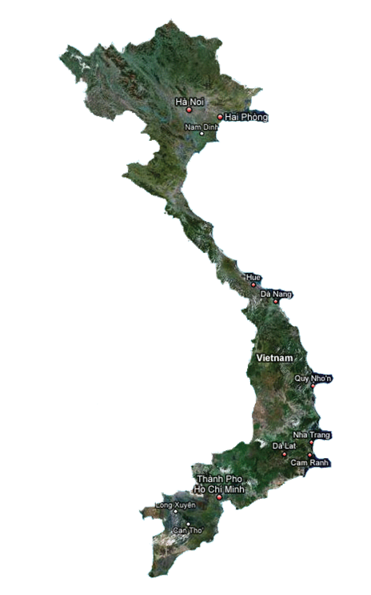
Synthesis of the activities carried out
7. Experience and knowledge exchange in terms of Emergency preparedness and response:
Share of experience in EC on the Legal framework and regulations for Emergency preparedness;
Elaboration of Planning and implementing emergency preparedness and response for NPP and nuclear activities in Viet Nam and neighbouring countries;
Public communication in Emergency situation for managing events occurred in Viet Nam or in neighbouring countries;
Participation in Emergency drill organised in Europe;
Share of experience in EC on managing Emergency situation with neighbouring countries

Slide 18
Main conclusions
Effective transfer of knowledge and methodology has taken place between EU and Vietnamese experts for increasing the national capabilities for independent review and assessment of safety submissions;
Over the five years, VARANS experts have shown remarkable progress developing technical structure, methods and tools used for its missions as regulator;
Excellent cooperative team-spirit;
The cooperation with European Union shall be continued

